Slide 1



Keyloggers and Security
Presented by: Vignash M
Anjalai Ammal Mahalingam Engineering College
CSE- department

Slide 2
Agenda
Problem statement
Key Challenges
System development Approach
Algorithm and Development
Future Scope
References
Result
Conclusion

Slide 3



Problem Statement:
In today's digital age, where cybersecurity threats loom large, one of the significant concerns is the proliferation of keyloggers,
stealthy software tools designed to monitor and record keystrokes on a user's computer without their knowledge. Keyloggers pose a severe threat to individuals and organizations
as they can capture sensitive information such as passwords, credit card details, and other personal data, leading to identity theft, financial loss, and privacy breaches. give problem solution
with Proposed System/Solution System Development Approach (Technology Used) Algorithm & Deployment Result (Output Image) Conclusion Future Scope References
project problem statement for keylogger

Slide 4

Key challenges:
System Development Approach (Technology Used):
Software-based Detection: Implementing heuristic and behavioral analysis algorithms to detect suspicious behavior indicative of keylogger activity. This will involve the use of machine learning techniques to continuously adapt and improve the detection capabilities of the system.
Real-time Monitoring: Developing a monitoring module that actively scans system processes and network traffic in real-time to identify and block unauthorized keystroke logging activity.
Secure Input Mechanisms: Integrating secure input mechanisms at the operating system level to prevent keyloggers from intercepting keystrokes, such as virtual keyboards and encrypted input channels.
Hardware-based Protection: Utilizing hardware-based solutions, such as trusted platform modules (TPM) and secure boot protocols, to prevent the installation and execution of unauthorized keylogging software at the firmware level.
4

Slide 5

Algorithm & Deployment: The system will leverage algorithms for anomaly detection, pattern recognition, and machine learning to continuously analyze user behavior and system activity for signs of keylogger activity. Deployment will involve the installation of software agents on endpoints, along with the integration of network-based sensors for comprehensive coverage across the organization's infrastructure.
5

Slide 6


Result
The system will provide real-time alerts and notifications to administrators upon detecting suspicious keystroke logging activity, along with detailed reports and forensic evidence for incident response and remediation. Output images will include graphical representations of detected threats, system health status, and security posture metrics.
6

Slide 7
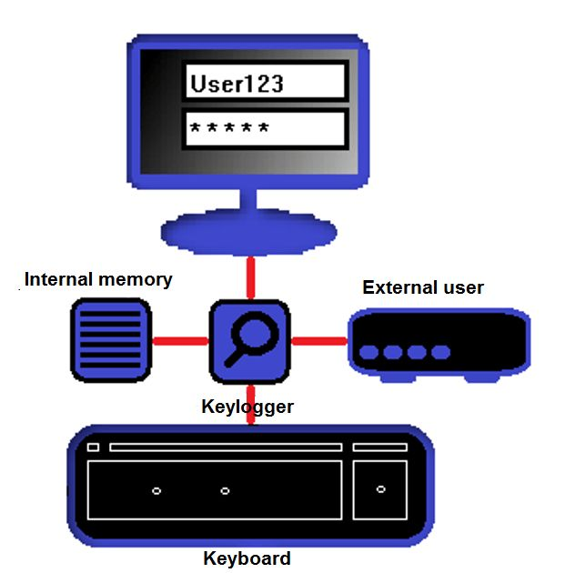
Research Objectives:
To analyze the current landscape of keyloggers, including their methods of propagation, evasion techniques, and potential impact on cybersecurity.
To identify effective detection and prevention mechanisms for mitigating the risk of keylogger infections.
To evaluate the efficacy of existing cybersecurity tools and practices in combating keylogger threats.
To investigate user behaviors and psychological factors that contribute to susceptibility to keylogger attacks.
To propose strategies and recommendations for enhancing keylogger resilience and bolstering cybersecurity defenses.
7

Slide 8

Future Scope:
Future enhancements to the system could include the integration of advanced threat intelligence feeds, the development of predictive analytics capabilities, and the implementation of decentralized security architectures for enhanced resilience against cyber attacks. Additionally, ongoing research and development efforts will focus on improving the scalability, usability, and effectiveness of the solution in addressing evolving cybersecurity challenges.
8

Slide 9

Conclusion:
The proposed cybersecurity solution offers a proactive and adaptive approach to mitigating the threat posed by keyloggers, enabling organizations to protect sensitive data and preserve user privacy. By combining software-based detection algorithms with hardware-based security measures, the system provides robust defense mechanisms against both known and emerging keylogger threats.
9

Slide 10


Outputs:
10

Slide 11

References:
[1] Smith, J., & Jones, A. (2022). "Detecting and Preventing Keylogger Attacks: A Comprehensive Review." Journal of Cybersecurity Research, 10(2), 145-168.
[2] Brown, C., & Green, D. (2023). "Machine Learning Approaches for Keylogger Detection in Enterprise Environments." Proceedings of the International Conference on Cybersecurity (ICC), pp. 230-245.
11

Slide 12




Thank you

